Slide 1
DEMOCRACY

Slide 2
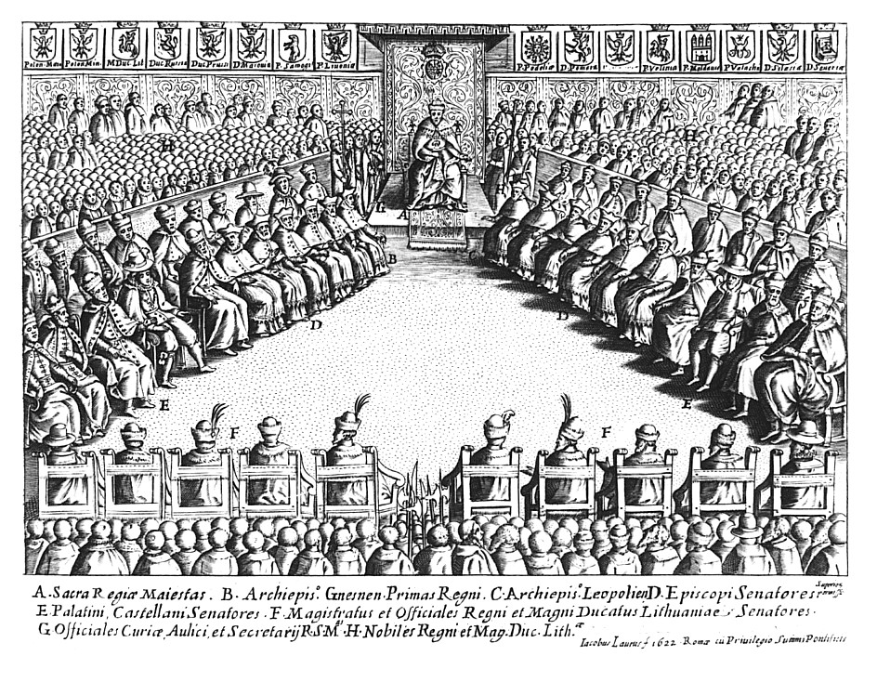
Noblemen's democracy
The system prevailing in the 15th and 16th centuries in the Kingdom of Poland, and then of the Polish-Lithuanian Commonwealth. In principle, he guaranteed the masses of the nobility the right to vote and decide on state matters, and was to be an example of tolerance and formal equality of rights within the noble state itself.
The beginning of nobility democracy is usually adopted - as a rule - in 1454, in which noble councils under the privileges of Nieszawa received broad competences in state-wide matters. The Sejm included the king and members of the chamber of deputies and the senate. There were 170 deputies in the parliamentary chamber, that is, representatives of the nobles elected at pre-septic diets. The Senate was made up of members of the former royal council, ie dignitaries of the clergy and laity as well as the highest royal officials.

Slide 3
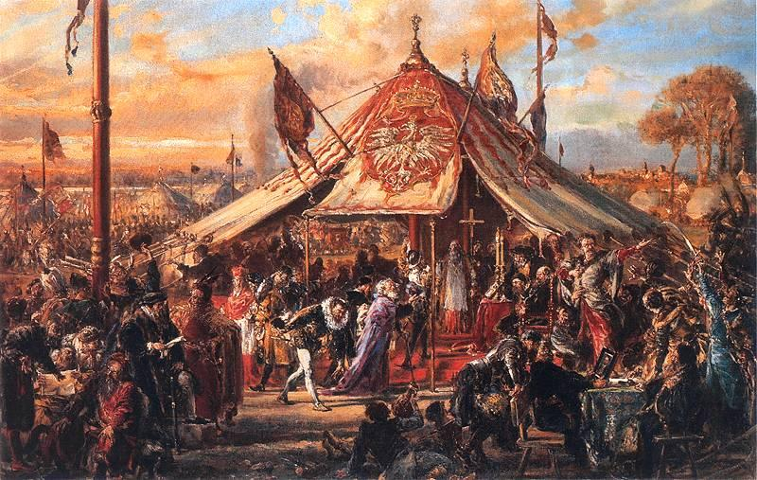
Free election
Choice of a monarch disrespecting the rules of dynastic succession. In the Polish-Lithuanian Commonwealth, she came to the electoral field in the mode of the common uprising, voivodship voted in the presence of deputies who raised her votes to the Senate: the king's election was announced by the marshal, and the primate of Poland appointed him. The senators led the leading role in determining the final results of the free election. The first free election in Poland took place in 1573 in the village of Kamion near Warsaw, a year after the death of the last of the Jagiellons - Zygmunt II August.

Slide 4
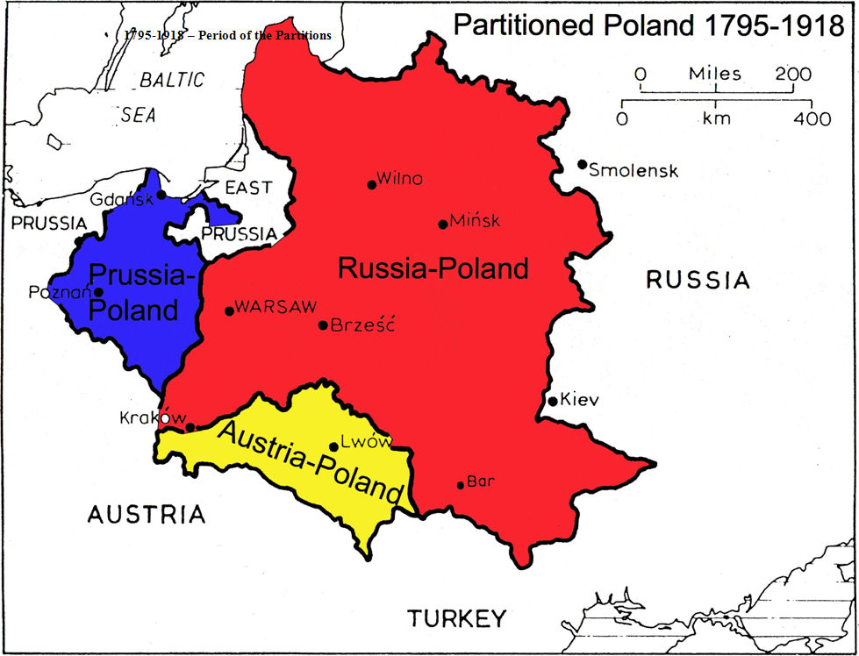
Polish lands under partitions
The First Partition of Poland - 1772 (Russia, Prussia, Austria)
The Second Partition of Poland - 1793 (Russia, Prussia)
The Third Partition of Poland - 1795 (Russia, Prussia, Austria)

Slide 5
MAY COUP (POLAND)
The May Coup was a coup d'état carried out in Poland by Marshal Józef Piłsudski between 12 and 14 May 1926. The coup overthrew the government of President Stanisław Wojciechowski and Prime Minister Wincenty Witos. A new government was installed, headed by Lwów Polytechnic Professor Kazimierz Bartel. The events were partly inspired by the need for extraordinary measures in the face of newly emerging threats to the stability of Poland's independence by Piłsudski's own assessment of the foreign treaties signed by Weimar Germany with France in 1925 (fundamentally abandoning Poland) and with the Soviet Russia in April 1926, to which Poland's representatives had not been invited.
Initially Piłsudski was offered the presidency, but he declined in favor of Ignacy Mościcki. Piłsudski, however, remained the most influential politician in Poland, and became the power behind the throne until his death in 1935.

Slide 6
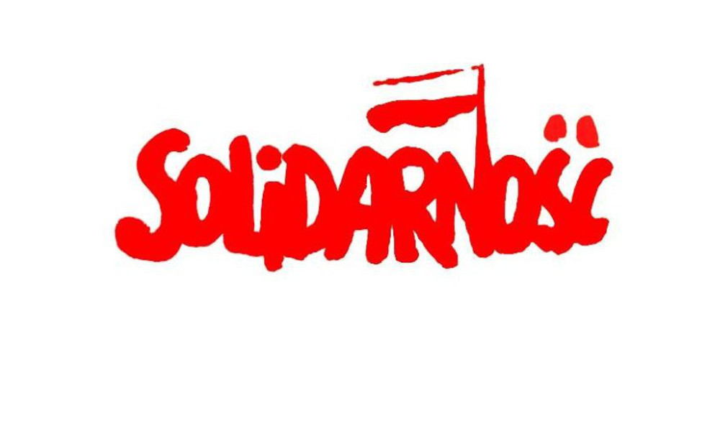
Solidarity (Polish
trade union)
In the 1980s, Solidarity was a broad anti-bureaucratic social movement, using the methods of civil resistance to advance the causes of workers' rights and social change. The government attempted to destroy the union by imposing martial law in Poland, which lasted from December 1981 to July 1983 and was followed by several years of political repression from 8 October 1982, but in the end it was forced to negotiate with Solidarity. In the union's clandestine years, Pope John Paul II and the United States provided significant financial support, estimated to be as much as 50 million US dollars.
The round table talks between the government and the Solidarity-led opposition led to semi-free elections in 1989. By the end of August, a Solidarity-led coalition government was formed. In December 1990, Wałęsa was elected President of Poland. Since then Solidarity has become a more traditional, liberal trade union. Its membership had dropped to 680,000 by 2010[3] and 400,000 by 2011.
Independent Self-governing Labour Union "Solidarity"— is a Polish labour union that was founded on 17 September 1980 at the Lenin Shipyard under the leadership of Lech Wałęsa. It was the first trade union in a Warsaw Pact country that was not controlled by a communist party. Its membership reached 9.5 million members before its September 1981 Congress (when it reached 10 million), which constituted one third of the total working-age population of Poland.

