Slide 1
Activities to support
an NGO

Slide 2
What does NGO stand for?
NGO means non-government organisation. It is an organization acting on behalf of a selected interest and not working to make a profit.
They operate on the basis of the national law of the organization's seat, and are created as a result of not an international agreement, but a civil law contract.

Slide 3
Amnesty International
An example of a non-governmental organization is Amnesty International. It aim is to prevent violations of human rights through any peaceful civic actions - from organizing writing letters to governments of countries breaking these laws, by publishing information on such violations, to real financial and legal assistance to injured people.

Slide 4
Where it all began
In 1961, British lawyer Peter Benenson was outraged when two Portuguese students were jailed just for raising a toast to freedom. He wrote an article in The Observer newspaper and launched a campaign that provoked an incredible response. Reprinted in newspapers across the world, his call to action sparked the idea that people everywhere can unite in solidarity for justice and freedom.
This inspiring moment didn’t just give birth to an extraordinary movement, it was the start of extraordinary social change.

Slide 5
What is Amnesty about?
Amnesty has grown from seeking the release of political prisoners to upholding the whole spectrum of human rights. Their work protects and empowers people - from abolishing the death penalty to protecting sexual and reproductive rights, and from combatting discrimination to defending refugees and migrants’ rights. They speak out for anyone and everyone whose freedom and dignity are under threat.

Slide 6
Regional Amnesty International offices
Amnesty International currently supports over 7 million people in 150 countries around the world. The Amnesty International secretariat is located in London, but the organization has regional offices in Africa, America, Asia, Europe and the Middle East.

Slide 7
Actions taken by our school to support Amnesty International
For the past six years, our school has participated in the campaign organized by Amnesty International – the marathon of writing letters. The goal is to write as many letters as we can to counter violations of human rights. Anyone who wants to take part in an action just comes and writes. The motto is: Write a letter. Change somebody's life! We believe that these letters will give someone hope, will change or save someone's life. writing letters is very popular in our school, teachers, students and their families come.

Slide 8
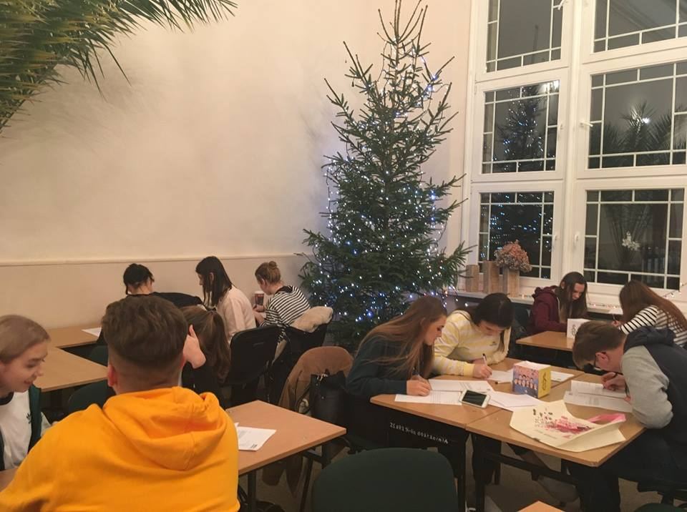
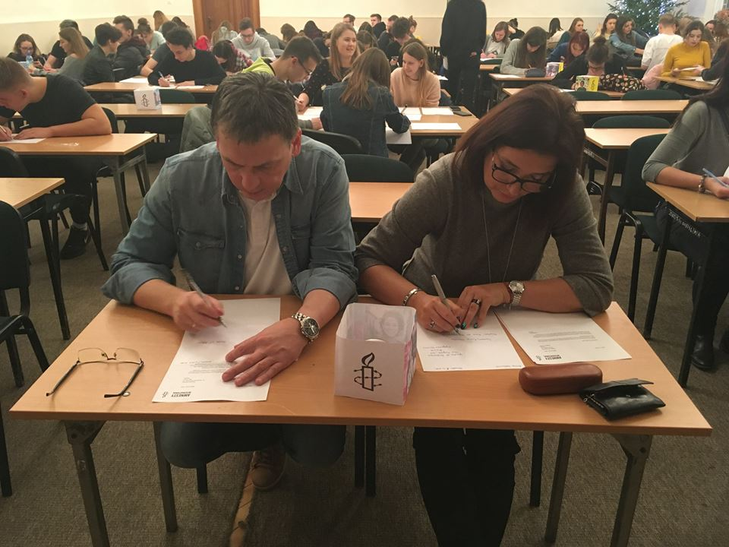

Slide 9
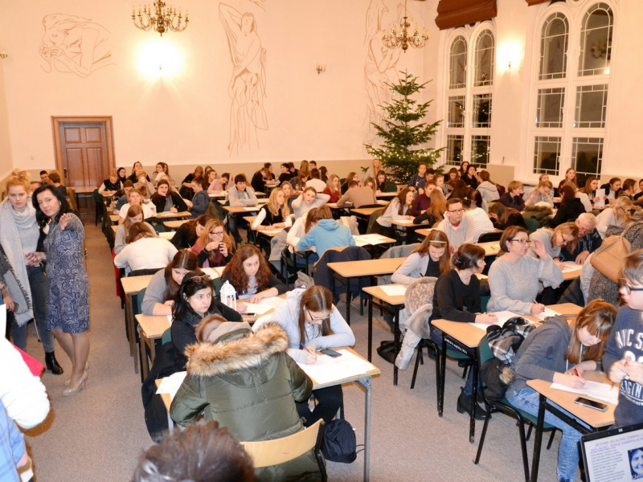

Slide 10
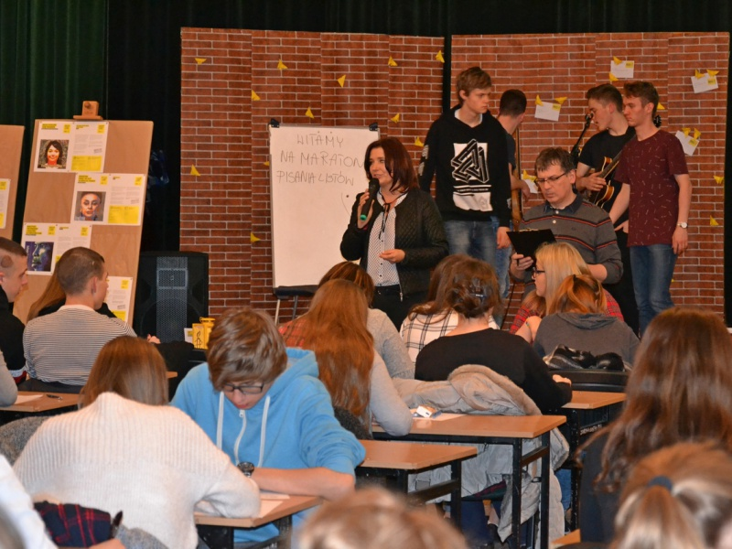

Slide 11
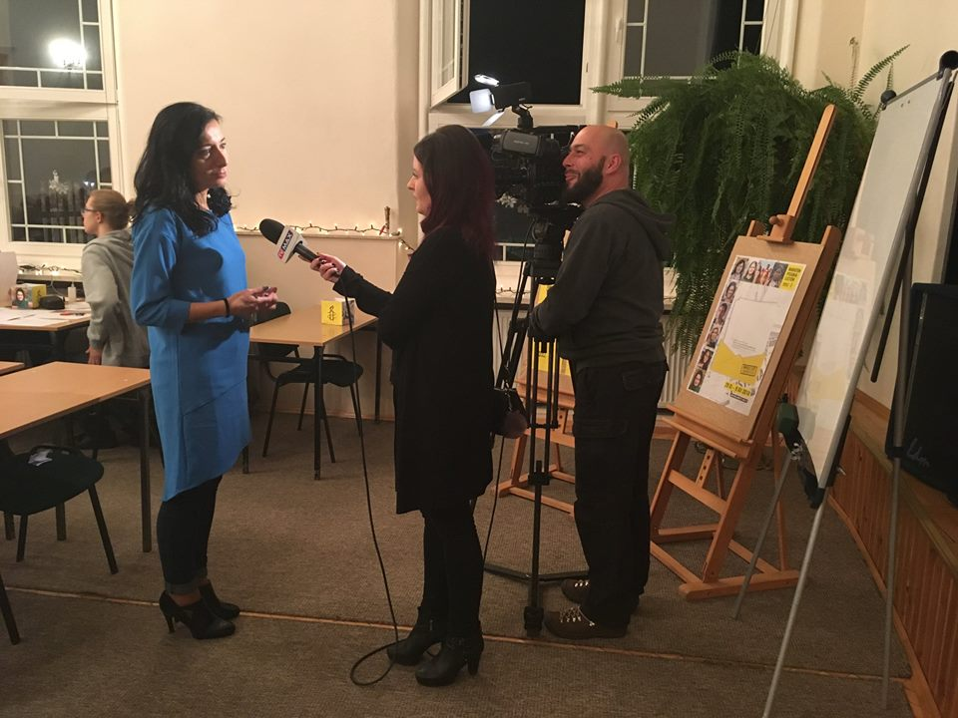

Slide 12
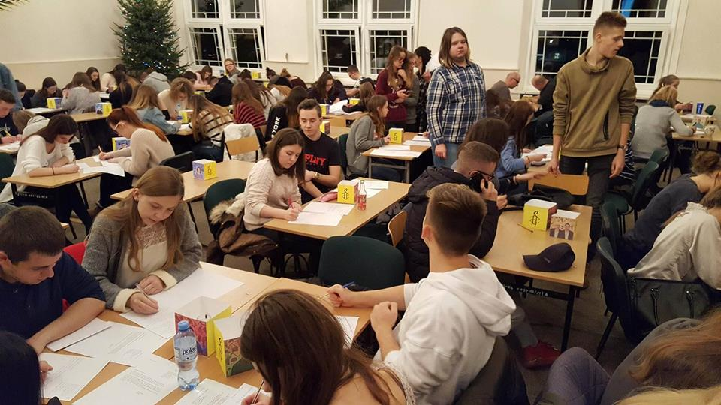

Slide 13
Thank you for your attention :)
Presentation made by Oliwia Stasiuk and Wiktoria Szczerba

