Slide 1
Fair Trade

Slide 2
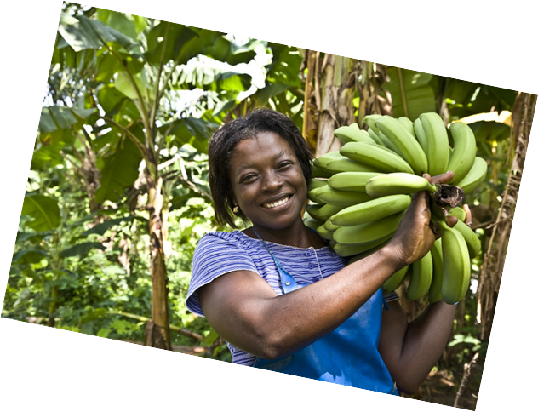
What is it?
An international movement of consumers, NGOs, importers, traders and small producers'; cooperatives in the Global South, etc. , aimed at helping small producers (farmers, craftsmen) to develop using business methods, creating an independent trading system with a global reach. At the same time, it is one of the trends in the social economy, whose guiding principle is to recognize that man is more important than profit.

Slide 3
Fair Trade objectives
Increase livelihoods for producers by increasing access to the market;
Strengthen producer organisations, pay better prices and ensure continuity of trade relations;
Support for the development of marginalized producer groups, especially women and indigenous peoples, and protection of children from exploitation in the production proces;
Raising awareness among consumers about the negative effects of international trade so that they have a positive impact through their purchasing power;
Creating an example of partnership in trade through dialogue, transparency and respect;
Campaigning for changes in the principles and practices of conventional international trade;
Protect human rights by promoting social justice, sound environmental practice and economic security.

Slide 4
Guiding principles
Respect and care for people and the environment, putting people's needs before profit;
Creating resources and opportunities for producers to improve their living and working conditions;
Purchasers pay a price that provides producers with fair remuneration for their work and an acceptable income for the trade organisation;
Increased awareness of the situation of women and men as producers and traders;
Promotion of equal opportunities for women;
Protecting the rights of women, children and indigenous peoples.

Slide 5
What do we need it for?
Almost half of the world's people live on less than 5 zlotys a day
900 million people in the world are starving
More than 120 million children do not go to school
A child born in the poorest part of Africa has 20 times less chance to live to old age than his or her peers in Poland.

Slide 6
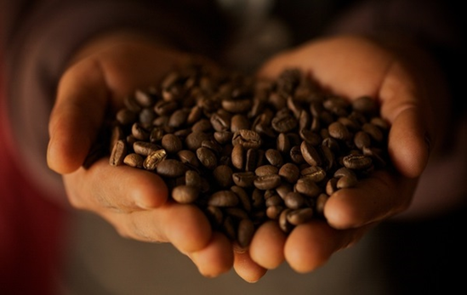
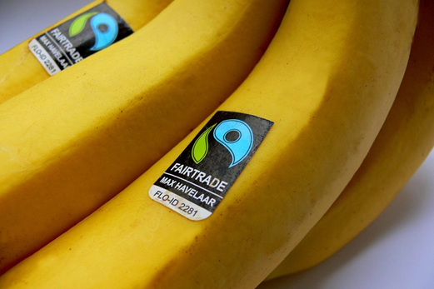
What products does Fair Trade include?
Fair Trade products are primarily coffee, tea, cane sugar, cocoa, tropical fruits, spices, nuts, rice, roses, wine, cotton, but also handicrafts and gold.

